Slide 1
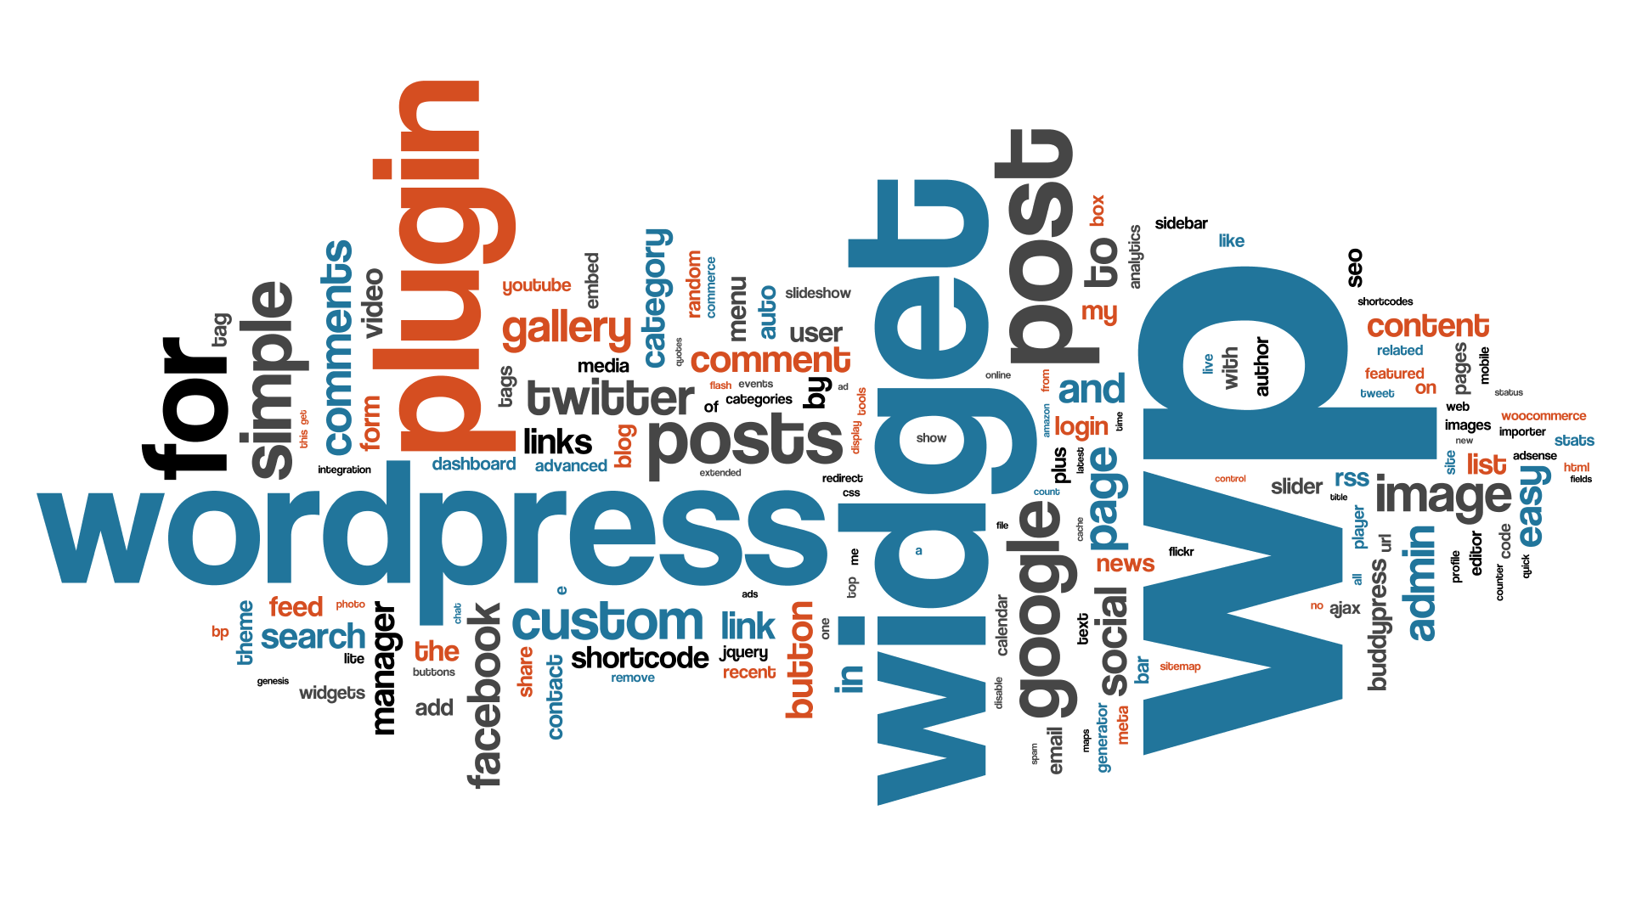

Slide 2
Agenda
Introduction
What is WordPress?
Why should you use WordPress?
Amazing WordPress statistics!
How to install WordPress?
How to set up a WordPress website?

Slide 3
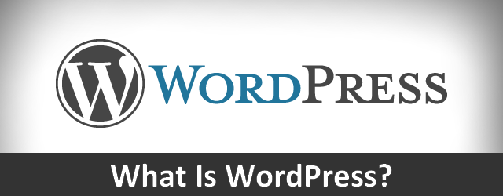

Slide 4
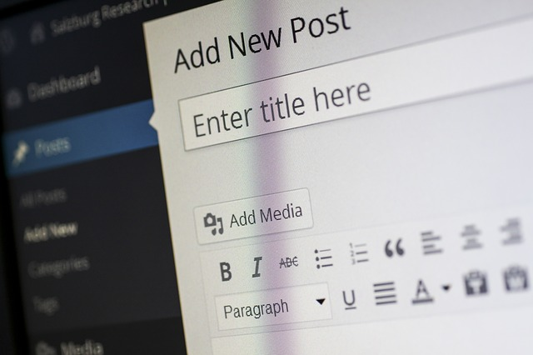
What is WordPress?
WordPress is the world’s most popular tool for creating and managing websites – any kind of website, from a simple blog to a full-featured business website.
It is a “content management system” (CMS) based on PHP and MySQL.
It was released on May 27, 2003.

Slide 5
Why should you use WordPress? (1)
WordPress is Free in Every Sense of the Word
It is a free software: this means you are free to download, install, use and modify it.
It is also open source, which means the source code of the software is available for anyone to study, modify and play with.
It is completely portable, so you can host your website anywhere and move it any time (something that can’t be said for other free website building tools like Wix or Weebly). → To run WordPress, all you need is a domain name and web hosting.

Slide 6
Why should you use WordPress? (2)
WordPress is Easy to Use and Learn
You don’t need any coding or design skills to create a professional looking site.
You become part of a huge WordPress community. You get free support from other community members.
There are tons of articles and tutorials written specifically for beginner level WordPress users.

Slide 7
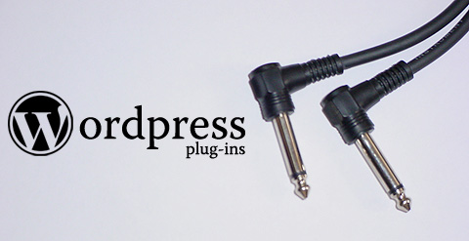
Why should you use WordPress? (3)
WordPress is Extendable by Using Themes and Plugins
There are thousands of free designs (“themes”) to choose from, so you can give your website any look you want. There is a perfect theme available for every kind of website.
→ WordPress themes are easy to customize because a lot of them come with their own options panel allowing you to change colors, upload logo, create a slider, etc.
WordPress can be extended by using (free) plugins, which can add extra functionality to your site.

Slide 8
Why should you use WordPress? (4)
WordPress is Easy to Manage
WordPress comes with a built-in updater that allows you to update your plugins and themes from within your WordPress admin dashboard.
It also notifies you when there is a new version of WordPress available, so you can update it by just clicking a button.
WordPress is Search Engine Friendly
By design WordPress is very SEO friendly.

Slide 9
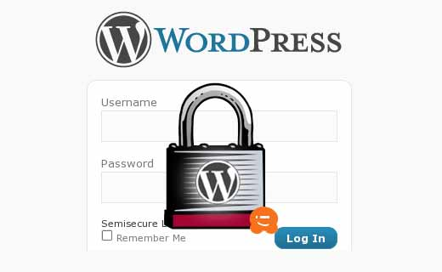
Why should you use WordPress? (5)
WordPress is Safe and Secure
WordPress is developed with security in mind, so it is considered quite safe and secure to run any website.
WordPress can Handle Different Media Types
Using WordPress you are not just limited to writing text. It comes with built-in support to handle images, audio, and video content.
You can easily embed Youtube videos, Instagram photos, Tweets, etc. by just pasting the URL in your post of web page.

Slide 10
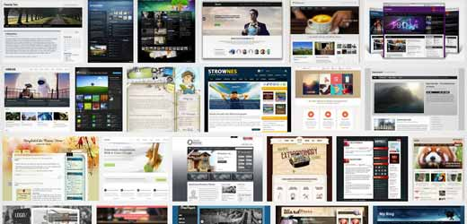
Why should you use WordPress? (6)
WordPress is Available in 51 Languages
While using WordPress, you are in Good Company
Many famous blogs, news outlets, music sites, Fortune 500 companies and celebrities are using WordPress. → https://wordpress.org/showcase/

Slide 11
Amazing WordPress statistics
WordPress is by far the most prominent CMS out there.
Around 48% of the top 100 blogs are managed with WordPress.
About 20% of all websites depend on WordPress.
WordPress.com gets more unique visitors than Amazon (126M per month versus 96M per month).
WordPress-related keywords score 37 million searches per month.
WordPress.com employs only 283 people.

Slide 12
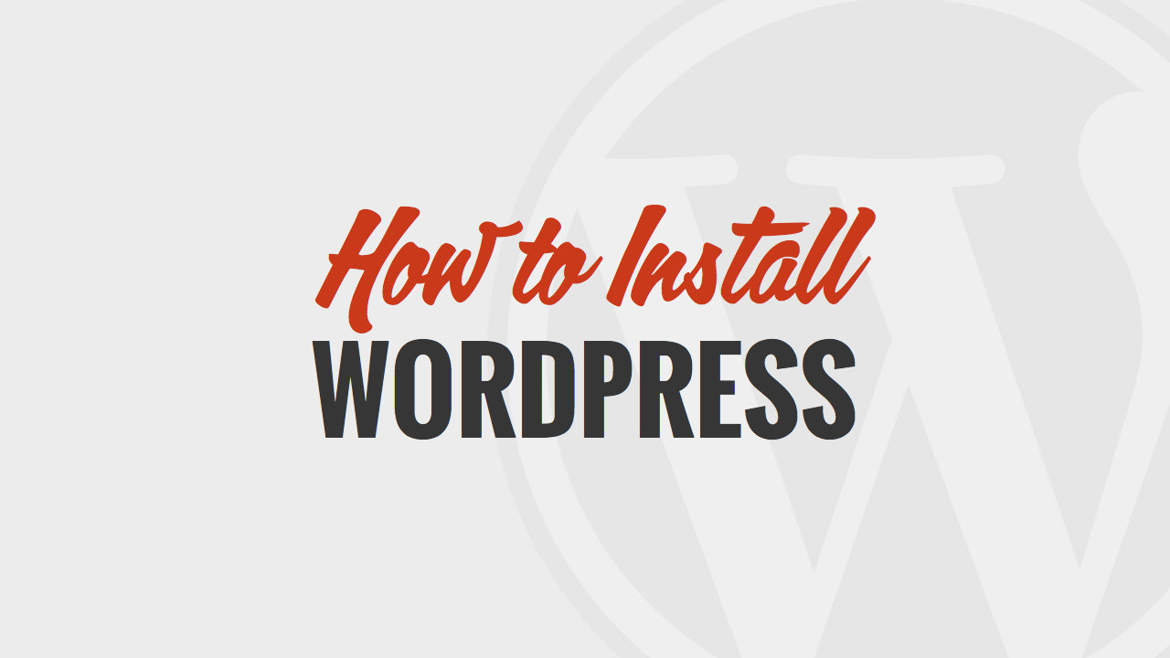

Slide 13
WordPress.com versus WordPress.org
What is the difference? It’s all about hosting.
With WordPress.org YOU host your own website. WordPress.org is where you’ll find the free WordPress software that you can download and install on a web server of your own choice.
WordPress.com, on the other hand, takes care of all of the hosting for you. You don’t have to download software, pay for hosting, or manage a web server.
Both WordPress.org and WordPress.com have pros and cons, depending on your needs.

Slide 14
WordPress.com
Advantages
No hosting costs
No managing a web server
Easy to set up
Customization options
→ While WordPress.com is free to set up, they do offer several premium
upgrades.
Disadvantages
URL will be yoursite/wordpress.com
Limited to only the pre-installed themes
You can’t use plugins
No access to your site’s code

Slide 15
WordPress.org
Advantages
Use your own domain name
Upload and install themes and plugins
Edit the code behind your site
Access your site’s database (or files)
→ WordPress.org opens up more control and flexibility for your site, but it also means more responsability.

Slide 16
How to install WordPress on your computer? (1)
Set up a local server environment or localhost, using XAMPP or WAMP
XAMPP or WAMP is a compilation of Apache web server, PHP and MySQL bundled for Windows computers.
Basically, you need XAMPP/WAMP to setup your own local server environment and to install WordPress on Windows.
Install XAMPP or WAMP on your PC and launch it.
XAMPP: open the control panel and activate the Apache Module and the MySQL module
WAMP: put the WAMPserver online [! Troubleshooting WAMP Skype Error]

Slide 17
How to install WordPress on your computer? (2)
Set up a new MySQL database for your WordPress site
XAMPP/WAMP comes with phpMyAdmin, a web based application to manage MySQL databases.
Go to your web browser and type in localhost/phpMyAdmin [Or: Click on the Wampserver icon in Windows taskbar and then click on phpMyAdmin].
Click on the Database tab and create a new database: choose a name for your database (f.e. test_db) and click on Create.

Slide 18
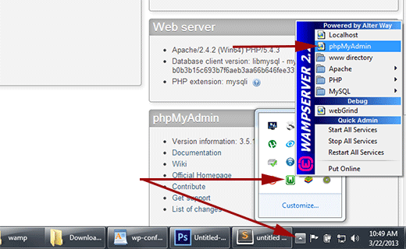
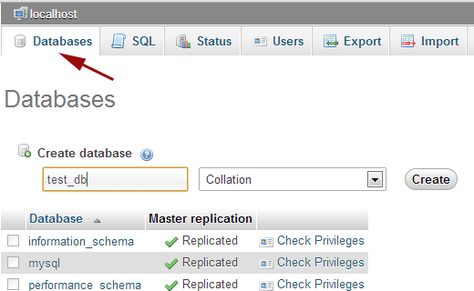

Slide 19
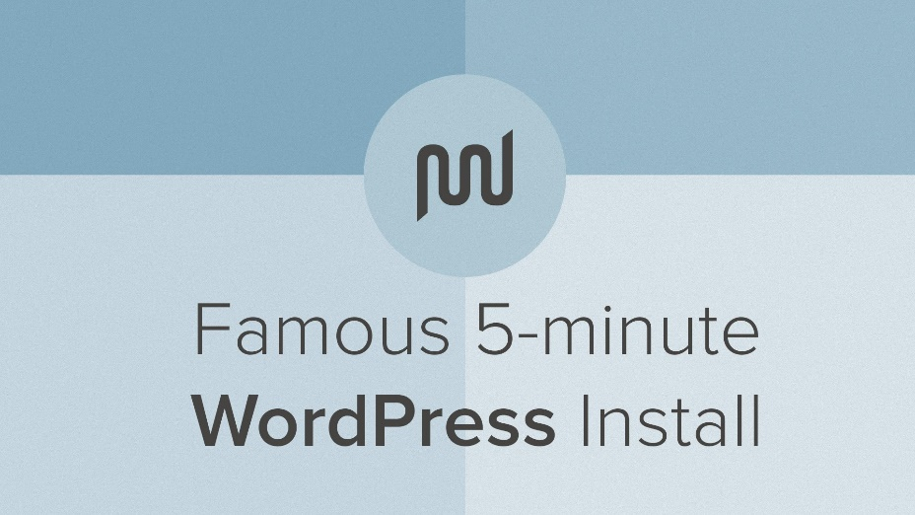
How to install WordPress on your computer? (3)
Download a copy of WordPress from WordPress.org
Extract the zip file
Copy the unzipped wordpress folder, go to
C:\xampp\htdocs OR
C:\wamp\www
and paste the wordpress folder there
Rename the wordpress folder (f.e. mysite)

Slide 20
How to install WordPress on your computer? (4)
Open a web browser, go to localhost/mysite and finish the installation wizard
WordPress will inform you that it can not find a wp-config.php file. Click on the Create a Configuration File button to create it.
On the next screen you need to provide your database information. The database name will be the one that you selected (f.e. test_db). [Please note that your default database username will be root and leave the password blank.]
Click on the Submit button and WordPress will create a configuration file for you.

Slide 21
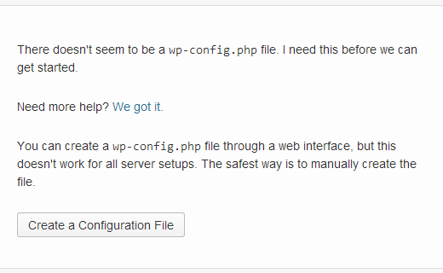
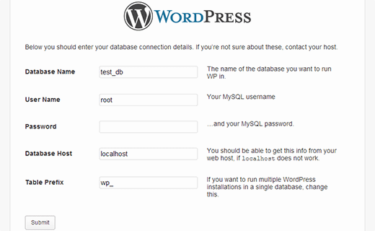

Slide 22
How to install WordPress on your computer? (5)
After this you will see a screen informing you that WordPress has successfully created the configuration file, and you can proceed with the installation. Click on Run Install button.
On the next screen, fill out the installation form. You need to provide a title for your website, choose (your own) admin username and password, and provide an admin email address. Finally press the Install WordPress button.
WordPress will quickly run the installation and create database tables. Once done you will see a success message after the installation. You can then proceed to your website by clicking on the Log in button.

Slide 23
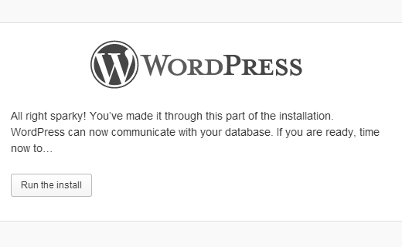
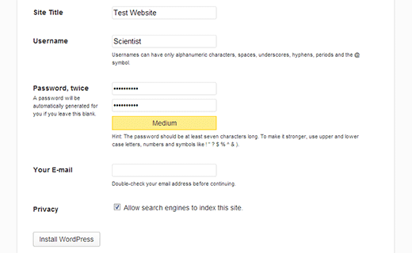

Slide 24
How to set up your WordPress website? (1)
WordPress Login URL: localhost/mysite/wp-login.php
It might be helpfull if you bookmark your site’s login URL.
Enter the username and password that you have chosen during the WP installation process.

Slide 25
How to set up your WordPress website? (2)
WordPress Admin Bar
Once you are logged in to your site, there is a black bar at the very top of the screen.
This admin bar is only visible to you when you are logged in to your site.
Next to the WP logo, you see the name of your site. By clicking this link, you jump towards the front end of your site. This is how your site looks to visitors.
On the right side of the admin bar you’ll see “Howdy, your name”. Here you can edit your profile or log out of the site.

Slide 26
How to set up your WordPress website? (3)
Exploring the WordPress Dashboard
The WP dashboard allows you to manage your site. It’s easy to use and to navigate.
First we take a look at the dashboard home screen:
After you first log in, you’ll see a top welcome box with some quick links to help you get started.
Other sections: At a Glance, Quick Draft, WordPress News, Activity
If you want to customize what sections you see, visit the Screen Options tab on the top right side of your screen (and unclick the checkbox beside the section you’d like to hide)
You can also drag and drop the boxes to change the order.
The other major component of the WP dashboard is the left-hand navigation menu.

Slide 27
How to set up your WordPress website? (4)
Exploring WordPress Settings (1)
WP General Settings
Site title and Tagline: make sure these titles match your site; they will be visible in Google search results.
WordPress Address and Site Address: it’s best to leave these two URLs alone
Email Address: used for admin purposes
Membership and New User Default Role: do you allow anyone to register for your site?
Timezone / Date format / Time format
! Don’t forget to click on Save changes.
WP Writing Settings
The settings on this page apply to writing and publishing content for your site.

Slide 28
How to set up your WordPress website? (5)
Exploring WordPress Settings (2)
WP Reading Settings
Here you can choose what is displayed on the front page of your site – either your latest posts or a fixed/static page.
You can also indicate the maximum number of posts to display and whether to show full text or a summary.
WP Discussion Settings
A lot of options to manage comments and to controll links to your posts/pages.
Default article settings: the third setting allow people to post comments on new articles; if you don’t want to allow people to comment, uncheck this box!
Other comment settings: you can choose the guidelines for how people post comments and how their comments are handled.
Avatar (profile image): you can enable the display of avatars for people who comment on your site.

Slide 29
How to set up your WordPress website? (6)
Exploring WordPress Settings (3)
WP Media Settings
Allows you to set maximum sizes for images inserted into the body of a post. [= great for saving time if you always want images to be the same size or if you want to apply default settings for medium and large image sizes.
WP Permalink Settings
Permalinks are the permanent URLs to individual pages and blog posts (i.e. they never change).
Here you can choose your default permalink structure.
By default, WordPress uses web URLs which have question marks and lots of numbers in them. You’ll problably want to change this to improve aesthetics and usability.
!! If you get a “page not found” error → check the rewrite_module in Apache.

Slide 30
How to set up your WordPress website? (7)
WordPress themes – what is it and how to install one? (1)
A theme provides the design or the style of your website, like colors, page layouts, fonts and other stylistics details.
On the Themes page in the Appearance menu, you’ll see the Active theme. Here you also see an option to Customize. If you click this link, you’ll see a preview window that allows you to make changes.
Next to the active theme, you’ll see a list of available themes that have already been installed on your WP site.
If you click on Add New, you can search for themes by keyword, or view the featured and newest themes from the WP theme directory. Here you can also filter themes by color, colums, features, etc.
→ You can choose from over a thousand free themes from the WordPress Theme Directory (or invest in paid themes).

Slide 31
How to set up your WordPress website? (8)
WordPress themes – what is it and how to install one? (2)
Click on Add New and search the “Responsive” theme. This is the theme we will work on.
Click on Install and Activate this theme.
Click on Customize:
At this moment, we will already customize the Default Layouts: change the Default Static Page Layout into “Full Width Page (no sidebar)”.

Slide 32
How to set up your WordPress website? (9)
WordPress Posts versus WordPress Pages
A post is what makes up the blog aspect of your site:
Posts are generally news or blog items.
Posts are dynamic and constantly changing the content of your site.
Posts are listed in reverse chronological order.
Posts can be tagged, categorized and even archived on your site.
A page is different because:
Pages are intended for static/fixed content or information (e.g. Contact page or About us page).
Pages are not listed by date and cannot be tagged or categorized like WP posts.
Pages can have a hierarchy.

Slide 33
How to set up your WordPress website? (10)
How to create a web page? (1)
Go to the Pages menu in the WP Navigation menu and click Add New.
Add the title of the page (e.g. Contact).
Next, add some content.
On the right side of the box, you’ll see two tabs = two ways of editing pages:
Visual tab: = WYSIWYG editor
It contains a toolbar with lots of options for formatting your page. If you are familiar with Microsoft Word, most of these icons should look familiar.
For most users, the visual editor is the easiest way to write pages.
Text tab: = a plain-text HTML version of the editor
You can use if you want to edit the HTML code of your page.

Slide 34
How to set up your WordPress website? (11)
How to create a web page? (2)
At the top of the right column, you’ll see the Publish box.
You can save your page as a draft.
You can get a preview of your page.
Or you can publish your page immediately
Below you find the Page Attributes.
Here you can apply a parent page or a template to your new page.

Slide 35
How to set up your WordPress website? (12)
How to add media to your web page? (1)
How to add pictures?
- Create a web page “Pictures” -
Above the editor toolbar, you’ll see an Add Media button. Click this button and you’ll see the Insert Media box.
WP uses a Media Library to store all of your media like images and videos.
You can choose to either upload a new file or use an existing file from the Media Library. To upload an image, click on the Upload Files tab.
On the right side of this box, you see the attachment details for the image. Here you can change the properties and choose the alignment / the URL / the size of the image.
Make sure the image has a checkbox and click Insert into page.
If you click on the image, you can edit or delete the image.
You also have the option to create a gallery.

Slide 36
How to set up your WordPress website? (13)
How to add media to your web page? (2)
How to add videos?
- Create a web page “Videos” -
Go to Youtube, select a video (e.g. WordPress tutorial), go to the option “Share” and copy the link.
Paste this link on your webpage. → You can easily embed Youtube videos, Instagram photos, Tweets, etc. by just pasting the URL in your post or web page.

Slide 37
How to set up your WordPress website? (14)
How to add media to your web page? (3)
How to add hyperlinks?
- Create a web page “Links” -
A hyperlink to an external website
A hyperlink to an internal website
A hyperlink to a pdf- or an office document
Select the text that you want to be hyperlinked.
Click the hyperlink button in the toolbar. This will bring up a box where you can enter the URL. You can also click a checkbox to open the link in a new tab.
If you want to link to existing content on your website, just click to expand this section.
To remove the link, select your text again and click the unlink button.

Slide 38
How to set up your WordPress website? (15)
How to create a custom menu?
As you have noticed: all pages appear in the main navigation menu.
In WordPress you can easily create a custom menu:
Click on the Menu link in the Appearance menu.
Enter your menu name and click Create Menu (e.g. Main navigation menu).
You can add menu items from the boxes on the left.
You can arrange your menu items in order.
You can change the navigation label.
You can create sub items.
Click Save menu.
If your theme includes more than one menu location, you can choose which custom menu to associate with each location (e.g. Top navigation menu).

Slide 39
How to set up your WordPress website? (16)
How to create a WordPress post?
A post is what makes up the blog aspect of your site.
Posts are dynamic, listed in reverse chronological order and can be tagged, categorized and even archived on your site.
Creating a post is very similar to creating a page.
One difference:
you can add tags (“keywords”) to your posts.
you can also organize your posts into different categories (“topics”), so you can group these posts together; categories, unlike tags, can be nested into hierarchies.

Slide 40
How to set up your WordPress website? (17)
How to create a WordPress post?
- create a web page Blog to publish all our posts; important: as template we choose Blog (full posts); afterwards we add this page to our main navigation menu –
Go to the Posts menu in the WP Navigation menu and click Add New.
Add the title of the post (e.g. My ideas about Green Open Access).
Next, add some content.
If you don’t have any categories yet, click the +Add new category link.
To assign a category to a post, click the checkbox next to the category.
Another way to manage categories is through the Post > Categories link.
Create some extra posts:
My ideas about Gold Open Access
The future of repositories

Slide 41
How to set up your WordPress website? (18)
Using WordPress Widgets (1)
On the right side of the blog page, you find some blocks: these are widgets.
WordPress widgets add additional content and features to your site (like archives, post categories, search bars, etc.).
One of the great things is that they require no code experience or expertise. They can simply be added, removed and rearranged.
The actual location of widgets on your site depends on your WordPress theme.
To see how widgets work, go to Appearance > Widgets panel:
On the left side of the page you see all available widgets.
On the right, you see all available widget locations.

Slide 42
How to set up your WordPress website? (19)
Using WordPress Widgets (2)
To add a widget to a location, simply drag and drop the widget.
To remove a widget, simply drag the widget back or click delete.
Examples:
You want to remove a few widgets from the main sidebar.
You want to add a search bar to the top of your website.
You want to add some content to the 3 home widgets:
Home widget 1: Text (Available e-sources)
Home widget 2: Recent posts
Home widget 3: Text (Institutional Repository)

Slide 43
How to set up your WordPress website? (20)
What are WordPress Plugins? (1)
Plugins are bits of software (small applications) that can be uploaded to add extra functionalities to your website.
There are tons of WordPress plugins available for free download from the WordPress Plugin Directory. Of course, there are also paid plugins.
You might be asking what types of things plugins can do. Well, if you can imagine it, there’s probably a plugin for that…
A plugin for a contact form
Plugins to add social media buttons / a photo gallery / a webshop / a fancybox
A plugin to backup your site or to check broken links on your site
A plugin to add Google Analytics to your site
Etc.

Slide 44
How to set up your WordPress website? (21)
What are WordPress Plugins? (2)
Installing WordPress plugins is a simple process.
Go to the Plugins menu.
On the Installed plugin page, you find a list of all the plugins currently installed on your site. Some plugins are automatically installed, like Akismet (a plugin to protect your blog from spam).
To install a new plugin, click the Add New link.
Here you have the option to search for plugins.
You can also click links to see featured, popular or new plugins.
!! Always check the ratings and the number of downloads.

Slide 45
How to set up your WordPress website? (22)
What are WordPress Plugins? (3)
Examples of excellent plugins:
Contact Form 7
Fancybox for WordPress
Broken Link Checker
TablePress
Google Analytics
BackWPup Free
…

Slide 46
How to set up your WordPress website? (23)
Creating users in WordPress
Allows you to add users with different roles and access privileges to your site.
Once created, a user will be able to log in to your site with a username and password.
WordPress user roles include:
Site administrator: has all rights
Editor: can publish posts/pages and can change posts/pages from other users
Author: can publish/change his/her own posts
Contributor: can write posts but cannot publish
Subscriber: can only change his/her profile

Slide 47
Interesting links (1)
How to move WordPress from your local server to your live site?
http://www.wpbeginner.com/wp-tutorials/how-to-move-wordpress-from-local-server-to-live-site/
Interesting links about WordPress:
https://ithemes.com/tutorials/what-is-wordpress/
http://wpapprentice.com/blog/wordpress/
http://www.anadguy.com/blog/2009/01/01/wordpress-what-is-it-how-do-you-use-it-why/
http://www.wpbeginner.com/why-you-should-use-wordpress/
https://wordpress.org/about/features/

Slide 48
Interesting links (2)
Interesting links about WordPress statistics:
http://expandedramblings.com/index.php/wordpress-statistics/#disqus_thread
https://managewp.com/14-surprising-statistics-about-wordpress-usage
http://blog.siteobservers.com/top-10-amazing-statistics-about-wordpress-cms/
https://blog.znetlive.com/9-interesting-facts-about-wordpress/

